Slide 1
Q
Figure 2 - SR Rotation Curve
tempo=0
tangent
q = sin θ
θ
φ
φ = cos θ

Slide 2
Q
Q-depth and Q-slack
tempo=0
Q-Slack
q = sin θ
Q-Depth
θ
φ

Slide 3
Q
Boundary-constrained Q-depth
Forbidden
Tempo=0 Q-lock limit
Boundary Limit
Allowed
θ
φ

Slide 4

Water Trough Analogy
Water-wave Phase Diagram
Boundary-constrained Q-depth
GPE+
Q
θ
φ
KE-
KE+
Allowed
Tempo=0 Q-lock limit
Boundary
Limit
GPE-
Forbidden
Water Tank

Slide 7
Effect of Q-slack on incompressible Water Wave travelling Towards Shore

Slide 8
Effect of Q-Slack on Compressible, doubly bounded Wave travelling Towards Shore

Slide 9

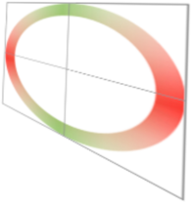
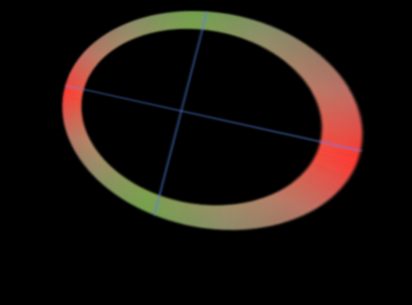

Slide 10
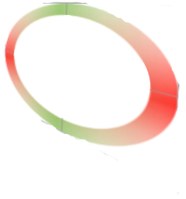

Slide 11



Effect of Q-Slack on
Transverse Wave

Slide 12
Time-and-Phase Lock at Boundary Due to loss of Q-slack in k-Domain
Q-depth
(0,1)
Tempo = Q-slack
(0,0)
(1,0)
Horizontal axis is in units or w=1/r

Slide 13


Time-and-Phase Lock at Boundary Due to loss of Q-slack in x-Domain
Wave motion (Z axis – physical in X-domain)
Boundary
Wave Crest
$$λ$$
Wave Crest
$$λ$$
Wave Crest
X axis (physical in X-domain)

Slide 14
Comparison of Q-slack effect for
Water and Energy waves
Shoreline
Zero Q-slack
Boundary
Boundary
Boundary
Wave movement
Wave movement
Water – Incompressible
Energy - Compressible

Slide 15
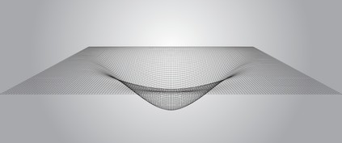

x
x
x

Slide 16
x
x
x
x

Slide 17
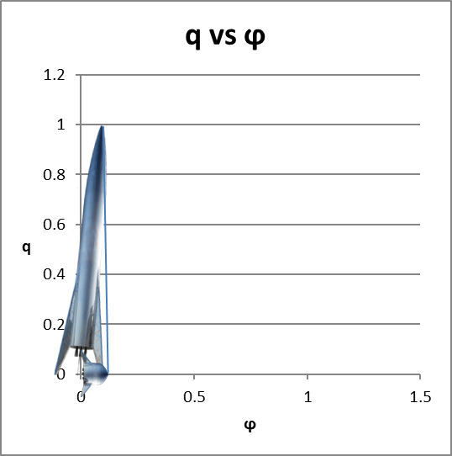

Slide 18
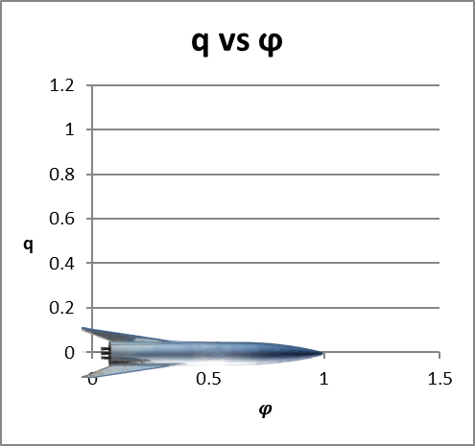

Slide 19


Slide 23


3. P-S-Q Rotation Diagram
S+
⨀
$$Q_{l}$$
$$θ$$
P-
⨂
⨀
P+
⨂
S-

Slide 26
Boundary

Slide 27
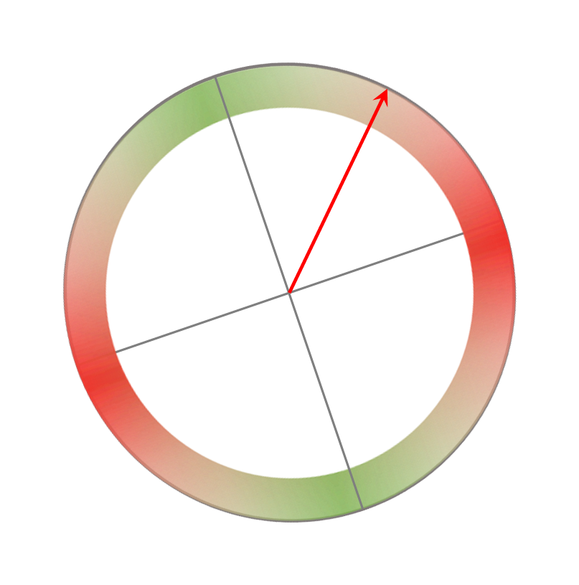
Original - Free space
B axis reduced
Y axis reduced
Ring rotated and vector rotated B=Y, reduced.

Slide 28
Boundary

Slide 30






Layer Transition Diagram - Q
$${Secondary}_{i}$$
Parent
$${Primary}_{i}$$
$$L_{i}$$
$Q_{i}$ Emergent axis / new degree of freedom
$$S_{i+1}$$
Child
$$P_{i+1}$$
$$L_{i+1}$$

Slide 31

Layer Transition Diagram – Q - Tilt
ϕ
θ

Slide 35
ϕ
θ

